Slide 1
Name: Wong Yi Tung Benjamin Student admin no: P7460926 AMPL CA 2

Slide 2
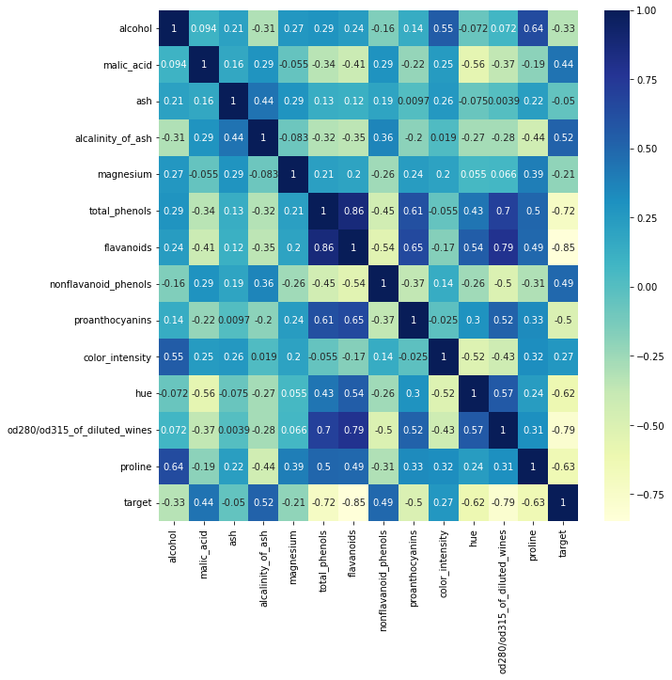

Slide 3
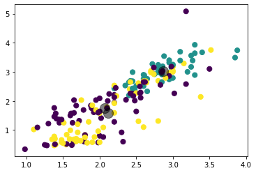
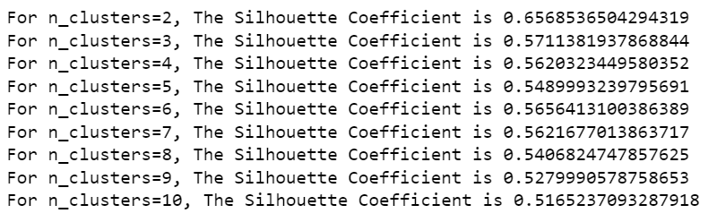
K-means clustering
From the heatmap, phenols vs flavonoids has the highest corelation. Phenols vs flavonoids is choosen for analysis

Slide 4
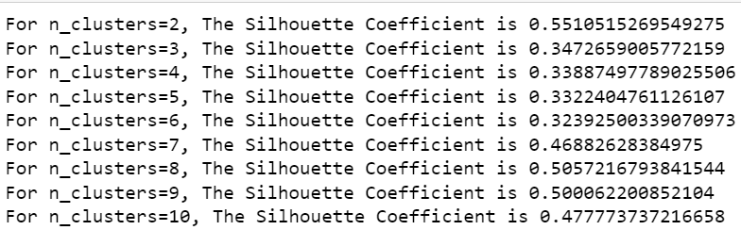
GMM

Slide 5
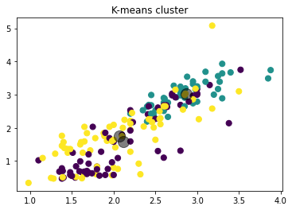
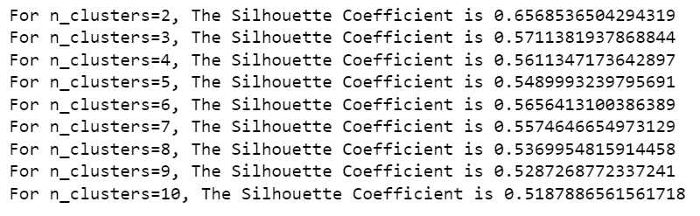
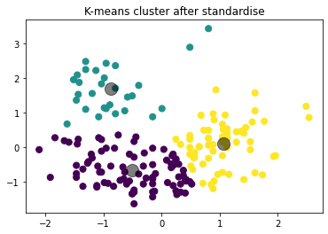
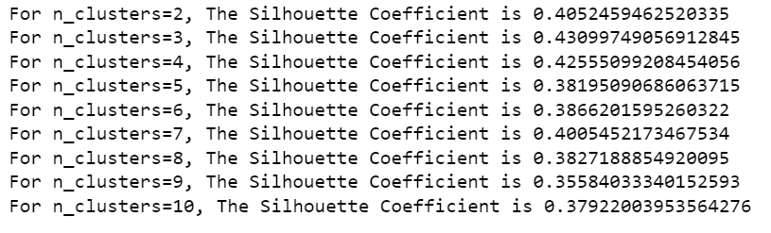
K-means clustering after standardise

Slide 6

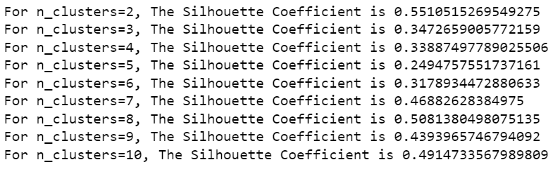
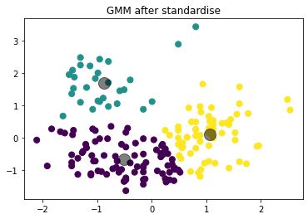
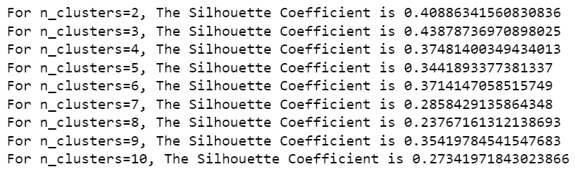
GMM after standardise

Slide 7
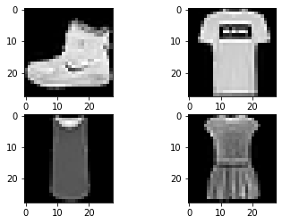
MNIST dataset preparation
Models used: MLP, CNN (default image), CNN
The models were fitted and run using 10 epochs. CNN had the lowest baseline error of 8.80%
After trying out different epoch and dropout values, CNN (default image) had the lowest baseline error of 7.73%

Slide 8
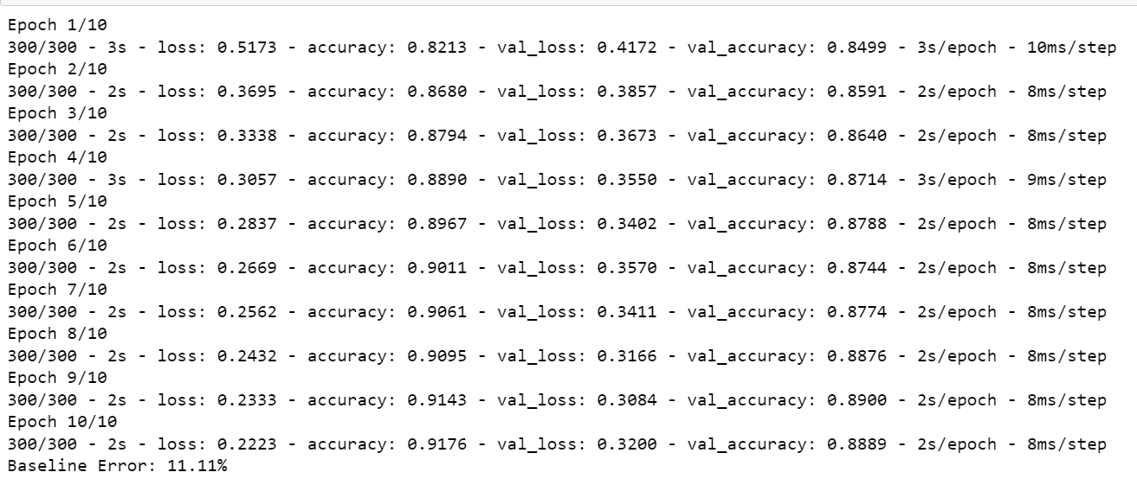
MLP model

Slide 9
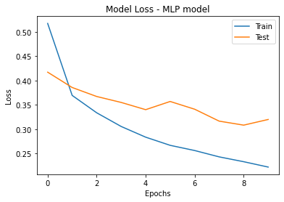
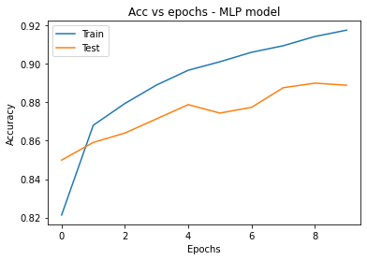
MLP model

Slide 10
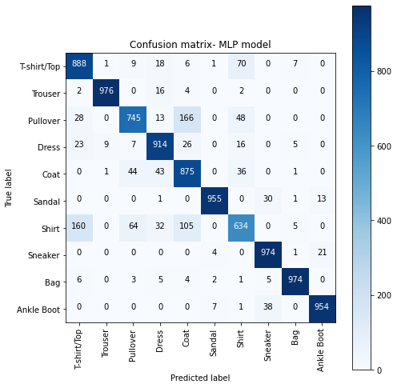
MLP model

Slide 11
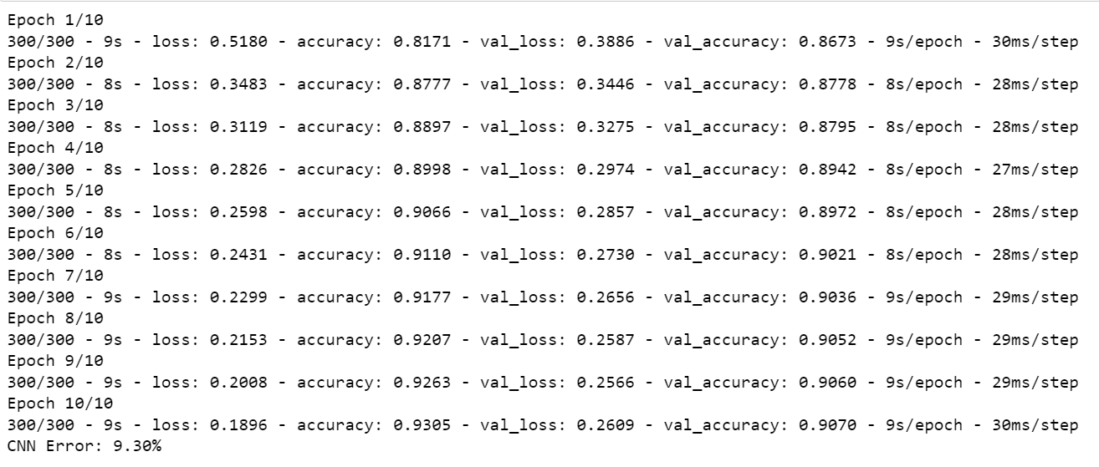
CNN (default image)

Slide 12
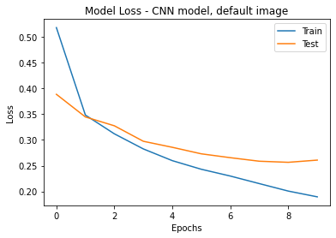
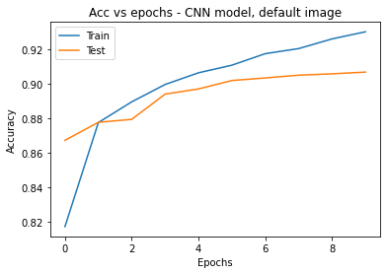
CNN (default image)

Slide 13
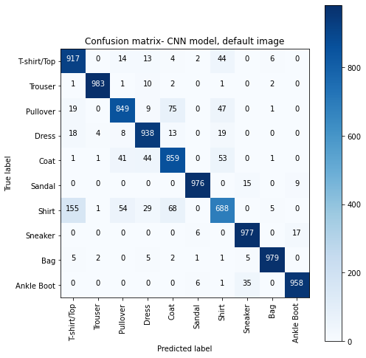
CNN (default image)

Slide 14
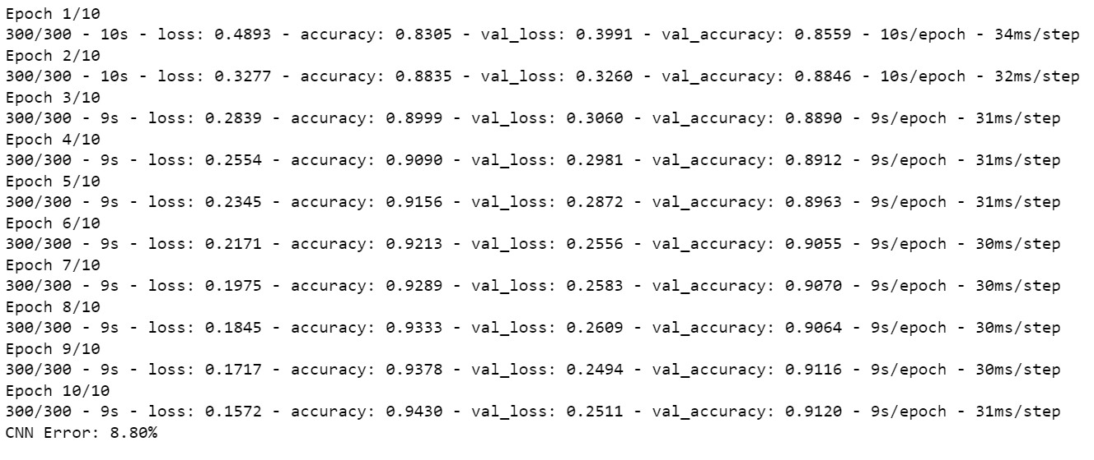
CNN

Slide 15
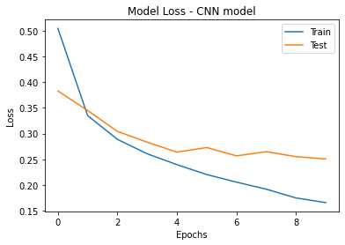
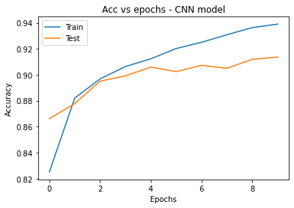
CNN

Slide 16
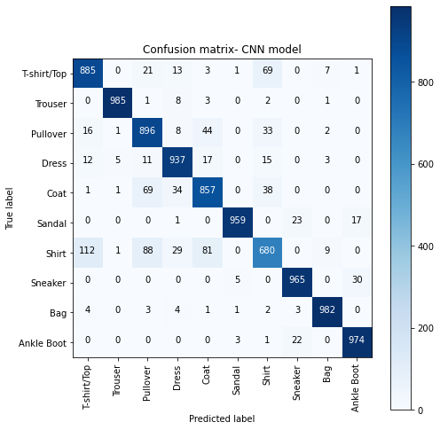
CNN

Slide 17
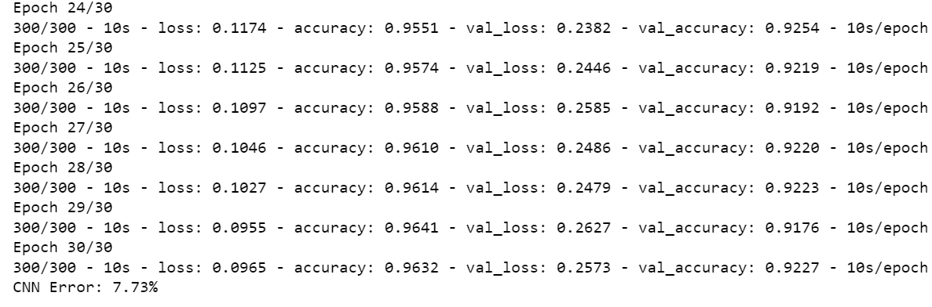
Epoch (30) and dropout (0.4) tuning (CNN default image)

Slide 18
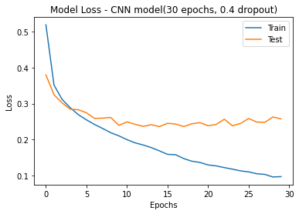
Epoch (30) and dropout (0.4) tuning (CNN default image)

Slide 19
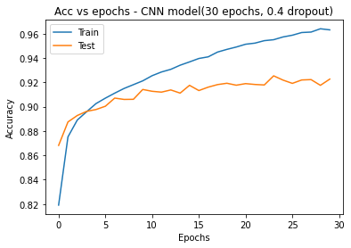
Epoch (30) and dropout (0.4) tuning (CNN default image)

Slide 20

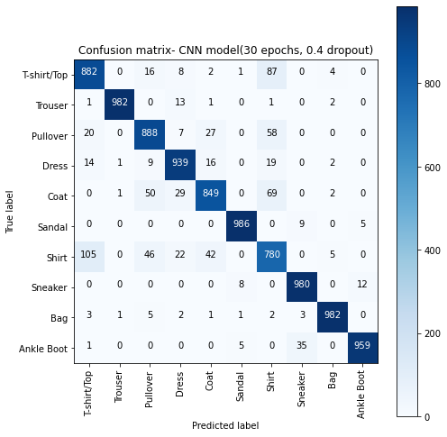
Epoch (30) and dropout (0.4) tuning (CNN default image)

